Slide 1

Citizen’s Fire Company #1
STATION 1
100 Chestnut Street
Mount Holly Springs, PA 17065
717-486-5151
STATION 2
405 Forge Road
Boiling Springs, PA 17007
717-258-6440

Slide 2
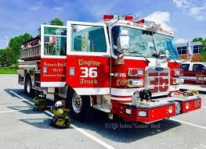
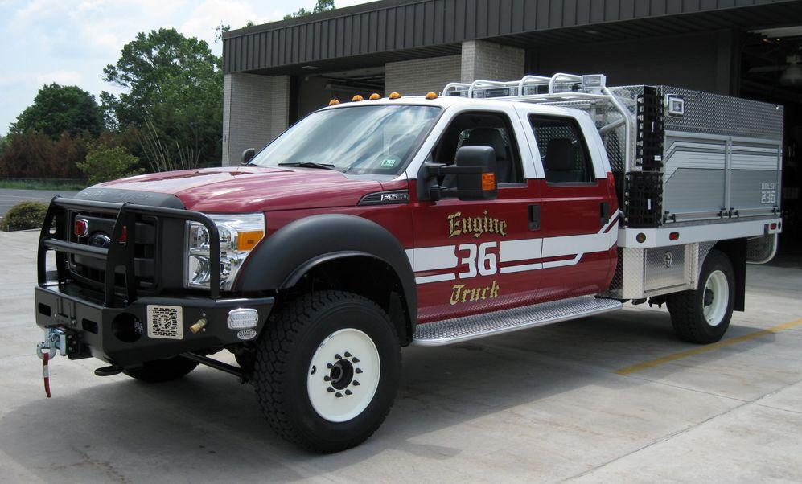
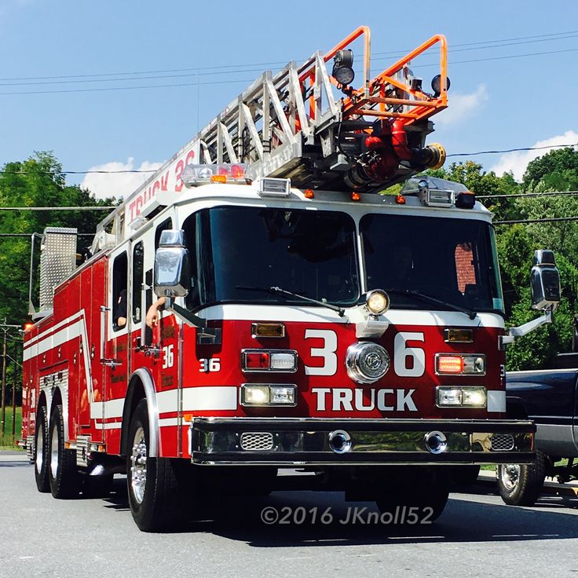
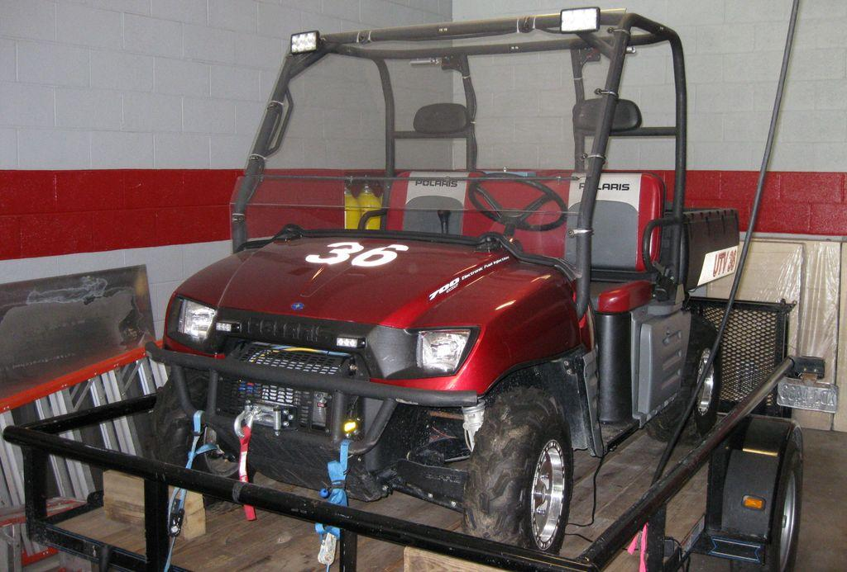
Apparatus
Station 1
Station 2
Engine 136
Engine 236
Truck 36
Brush 136
Utility 136/ UTV
Traffic 136
Engine 336
Brush 236
Utility 236
Traffic 236

Slide 3

Emergency? Dial 911
Call 911 for any EMERGENCY
Fire Department
EMS
Police

Slide 4
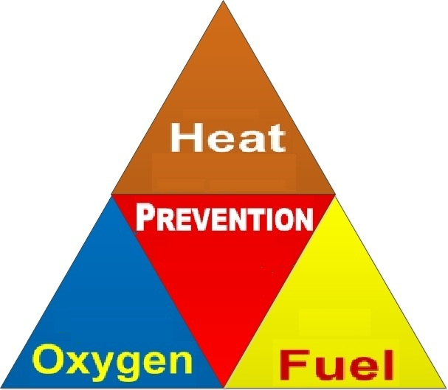

FIRE
Needs to have Heat, Oxygen, and Fuel to survive.
Taking away one of these will extinguish the fire.
Some ways to do this: Water, Dry Chemical extinguishers, CO extinguishers, and Smothering.

Slide 5
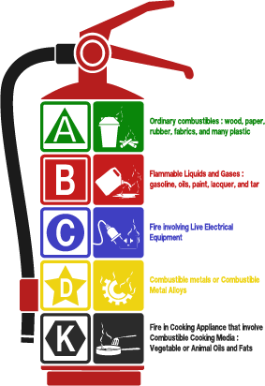
Extinguishing a Fire
Use a fire extinguisher (Adults ONLY)
  Pull the pin
  Aim at the base of the fire
  Squeeze the handle
  Sweep back and forth
Never use water on a grease fire
If there is fire in the oven, close the oven door

Slide 6
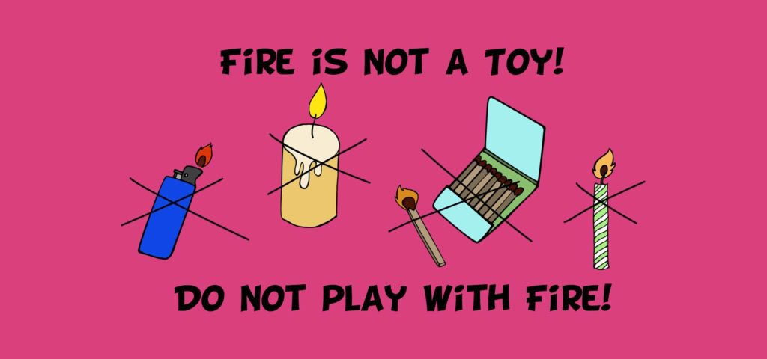
Ways to Prevent a Fire
Do NOT play with matches and lighters
Never leave the house or sleep with a candle lit
Always stay home when the oven is on
Keep objects away from heaters
Store gasoline properly
Never put water on grease (even if there is a fire from the grease)

Slide 7

Stay Safe!
Get Out, Stay Out
Plan and Practice
Do not re-enter the home for ANY reason until it is safe
If you have a pet, inform a firefighter
Have a family meeting place outside in case of a fire
Create your family meeting place a head of time
Have two ways out
Practice fire drills

Slide 8
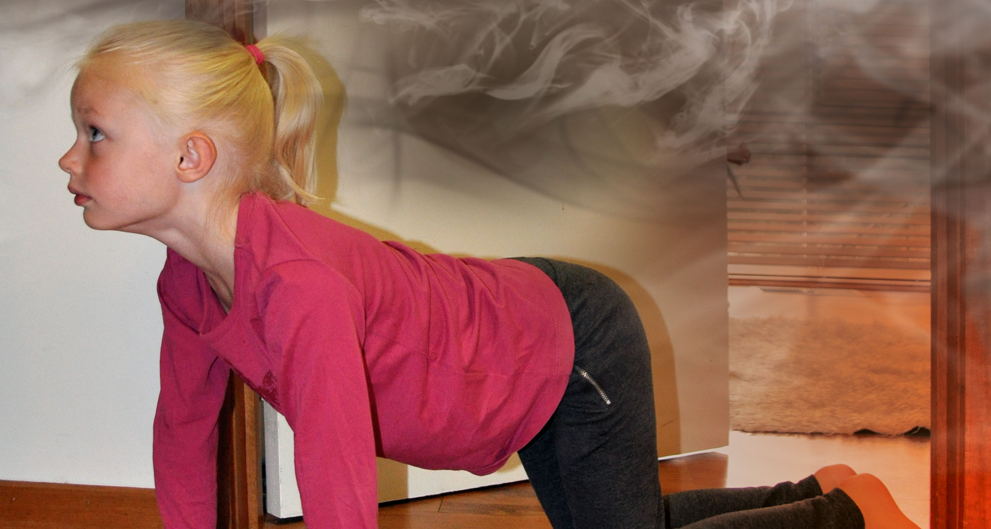
Stay Safe!
Low and Go!
Never Hide!
Keep yourself low to the ground beneath the smoke
If in a closed room, feel the door with the back of your hand to check for heat before opening
NEVER hide in closets or under the bed
Being visible will help a firefighter find you
When a firefighter is yelling out for you, answer “I’m Over Here” until they get to you

Slide 9

Beep, Beep, Beep!
All homes should have working smoke detectors
Always exit the house when the smoke detector sounds
Test your smoke detectors monthly

Slide 10
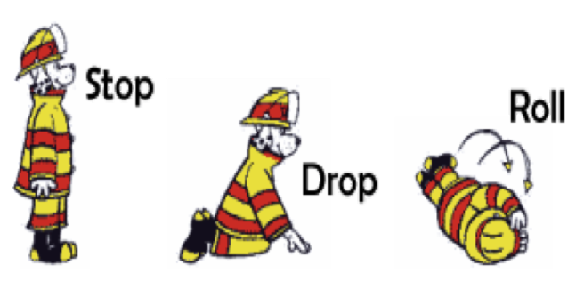
What would you do if your clothing caught on fire?
Stop what you are doing
Drop to the ground
Cover your face with your hands
Roll around until the fire is out

Slide 11

Only You Can Prevent Wildfires!
Always have a parent’s supervision with a campfire
Put your campfire out when done
Do not start your campfire under the trees
Do no burn when it is dry or windy

Slide 12

Stay Safe on the Road
Seatbelts Save Lives!
No Distracted Driving!
Slow Down to Save a Life!

Slide 13

THANK YOU FOR LEARNING WITH US!
Stay Safe!
For more information visit: Sparky.org

